Slide 1

WebYeshiva.Org
Student’s Guide

Slide 2
Welcome to WebYeshiva.org
WebYeshiva is a fully interactive Torah study program on the Internet, using the latest, yet easy to use, video-conferencing technology . It offers real-time, interactive classes, taught by a roster of world class Rabbis and teachers.
WebYeshiva.org offers the ability to join other Jews in an interactive Torah Shiur with its dynamic online classrooms and web presence.
WebYeshiva.org offers classes for students at all skill levels. You will find classes here even if you have never studied in Yeshiva and/or cannot read Hebrew.
You can consult a WebYeshiva staff member to find the classes most suitable for your learning level. To contact a WebYeshiva representative please see the contact information at the end of the manual.
We hope this user manual facilitates your usage of the WebYeshiva system .
Please do not hesitate to contact us if you have questions.

Slide 3
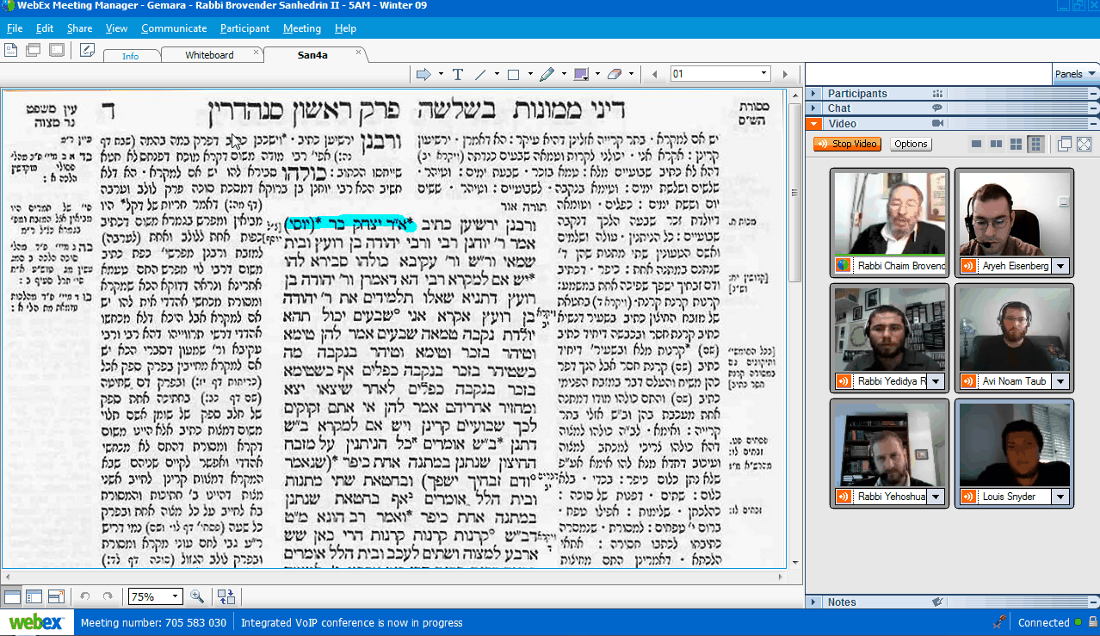
WebYeshiva- A New Type of Learning Experience
In just a few minutes, you can take advantage of this advanced, easy-to-use learning experience!

Slide 4

Basic Requirements for the System
To participate in a WebYeshiva.org class, you will need:
A computer with speakers..
A high speed internet connection (DSL, ADSL, Cable, Fiber Optics).
If you would like to be seen during class, a webcam is needed
If you would like to talk during class, and not just chat its important you have a high quality mic
that has noise cancellation.
The minimal upload speed needed is 0.250 mb/s (sometimes written as 250 kb/s). Ideal speed is at least .500 mb/s (500 kb/s). You can check your speed with your provider, or you can do your own speed check at http://www.speedtest.net.
I Before logging on to an online class at WebYeshiva.org, exit any games and other non-essential programs, including instant messaging, instant email notifications, etc.
It is especially important to log off Skype before logging in to a class, as the Skype has control of your webcam and VoIP, and can interfere with WebEx (the online classroom provider).
Recommended browsers: Explorer or Firefox for Windows, Safari for Mac.

Slide 5
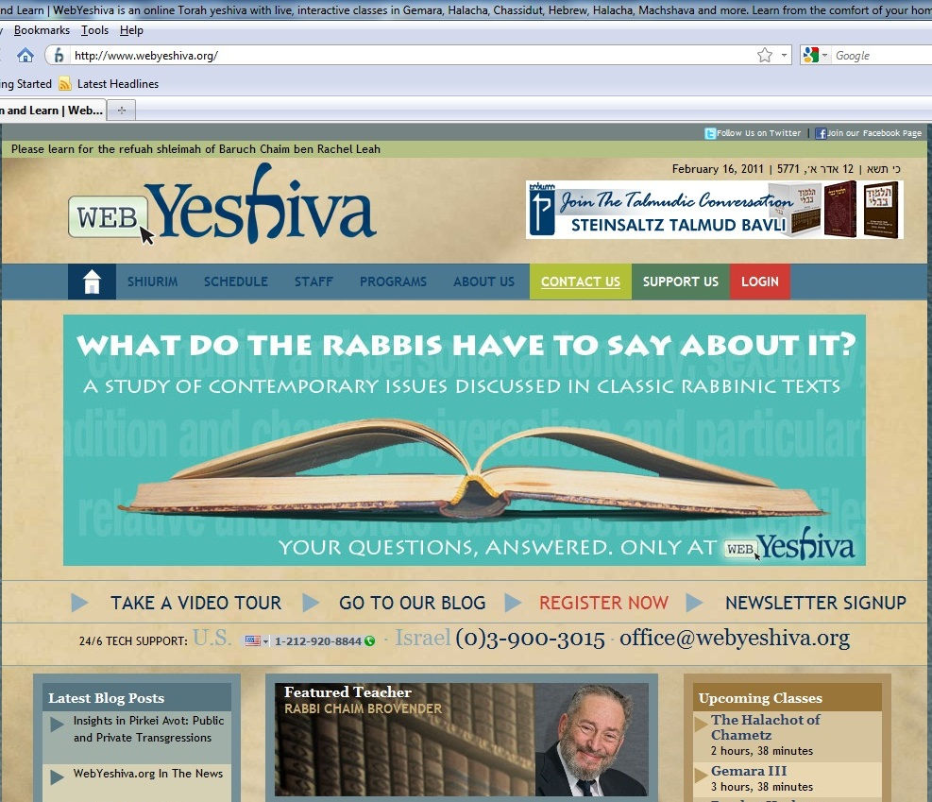
First, please register for WebYeshiva which is a very quick process. Go to www.webyeshiva.org and click on Register Now.
Edit Profile

Slide 6
Getting Started…
The Main Toolbar Menu
Log in
Edit Profile

Slide 7
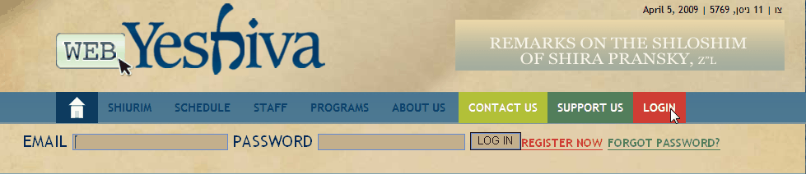
Getting Started…
The Main Toolbar Menu
Enter your email you used to sign up with on your application form, and the password you chose.
Edit Profile

Slide 8

Getting Started…
Setting Up Your Profile
WebYeshiva’s website offers a personalized experience for all users. It is important that your information be complete and up to date.
To update information click the edit profile button on the top of your screen.
Edit Profile

Slide 9
Getting Started…
Adding Classes
To find the list of courses to choose from click on either “shiurim” to see the full details of the shiur or “schedule” to see the list by weekly schedule form
Shiurim

Slide 10
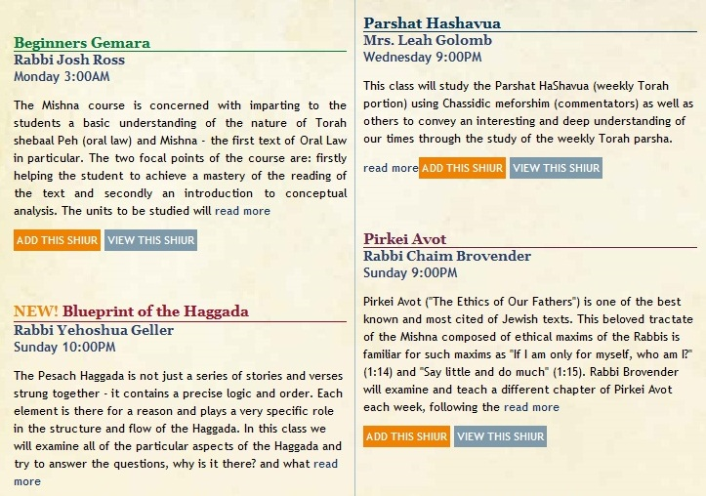
Getting Started…
Adding Classes
Find the class you wish to take and click “Add This Shiur”
Add This Shiur

Slide 11
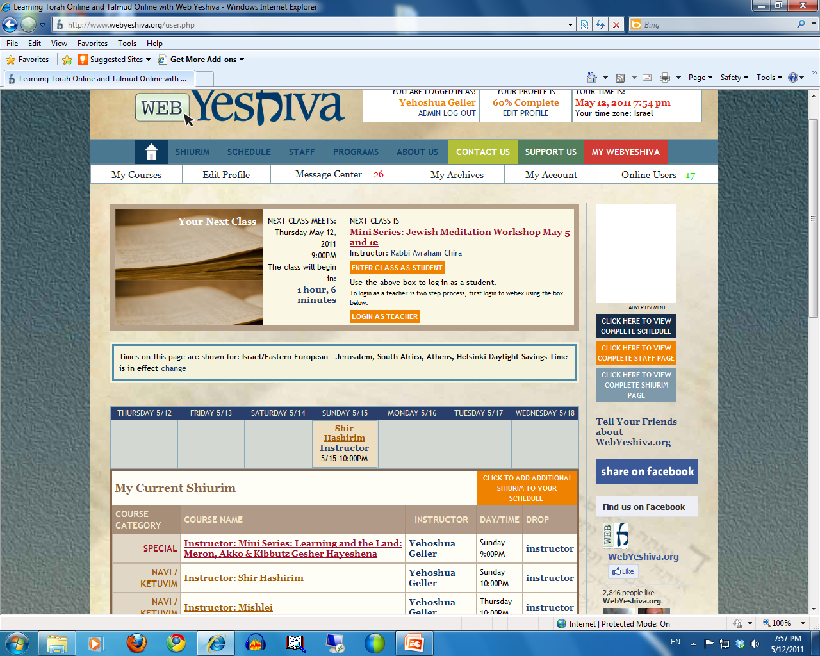
After logging in you will see a box enabling you to directly enter the upcoming web conference class
You will see your weekly calendar, where you can enter the class by clicking on the course in the calendar
On the bottom of the page is the list of your courses. You can click there as well to enter a course

Slide 12
Building an Interactive Environment
In the next slide we will review the class page
Every shiur has its own home page. Teachers use this page to share sources and other material with students, post messages, as well as other forms of communications.
Teachers update their class pages regularly.
The archives are accessed from this page as well.

Slide 13
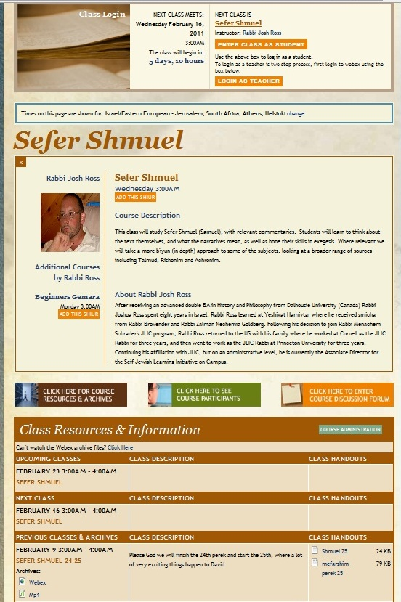
The class page
Time of the upcoming class
Class Name
Class Materials
Archives

Slide 14
WebYeshiva Student Teacher communication
WebYeshiva members are encouraged to share views and opinions with the on-line community.
Students and teachers communicate regularly through e-mail and other on-line mediums, creating a truly personal experience.

Slide 15
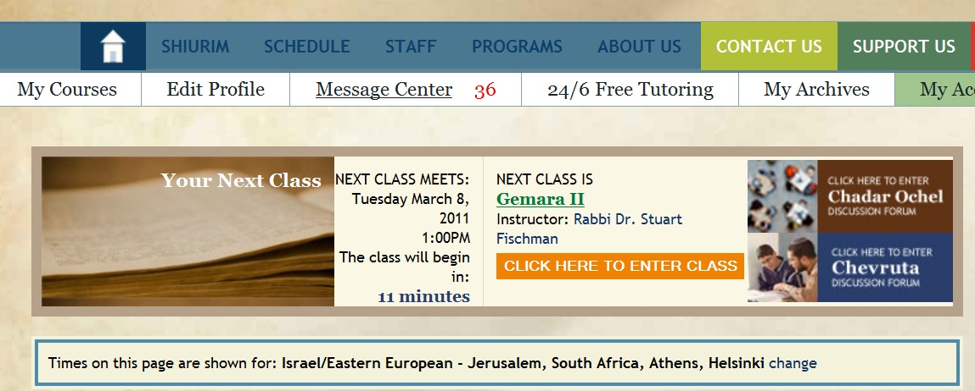
Welcome to the WebEx web conference classroom- Getting started
Students can enter a Shiur 15 minutes prior to the scheduled start time.
If one enters before 15 minutes, they will get an error.
Teachers are often on hand before the Shiur begins during this time to answer questions.

Slide 16
Setting Audio & Mic options
This should only need to be done the first time you enter a WebYeshiva session, unless you change computers, add/remove hardware or otherwise change your computer setup.
The first time you enter a class, log in to WebYeshiva and enter your session as early as possible to give yourself time to set it up properly. On the upcoming pages you will see the instructions how to set up the VoIP and webcam

Slide 17
WebCam & Video Options
It is not necessary to have a webcam to see and follow a shiur. While the teacher and other students will not be able to see you, you can still see them and participate fully in the shiur.
The same is true if you don't have a microphone (though speakers or a headset are of course critical to be able to hear the shiur). You will still be able to hear and see the shiur, but you will not be able to ask questions or interact fully in the classroom using the VoIP, though you will be able to communicate using the chat box.
You will find that having a webcam and mic will enhance your experience as well as your fellow student’s.

Slide 18
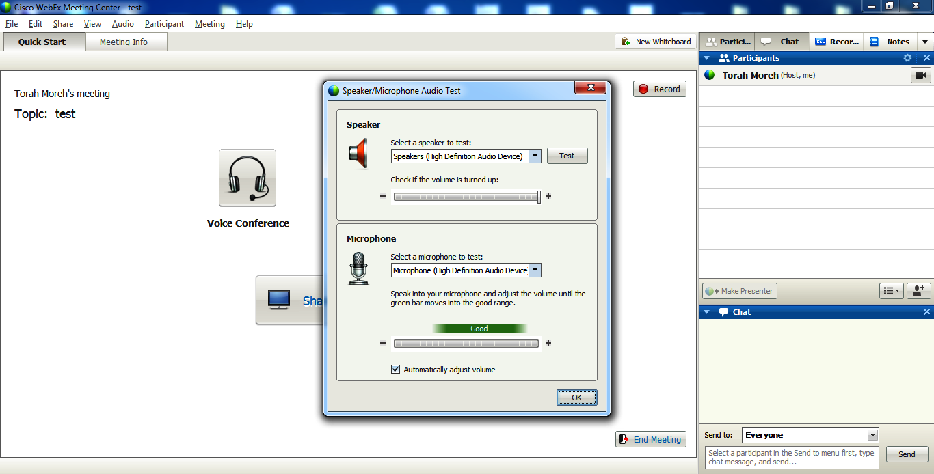
When you are prompted to join theWebex VoIP, you will also be automatically prompted to configure the Audio setup. This allows you to setup the speakers and microphone. Make sure to test the speaker and mic, and if the test doesn’t work, then try changing the speaker or mic in the drop-down box

Slide 19
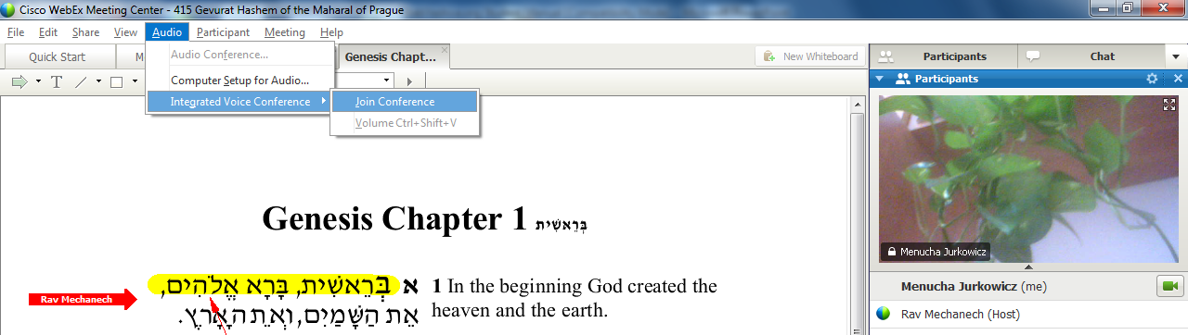
Audio setup
If for some reason you were not prompted to join the audio (it could be that the teacher did not turn it on, and therefore first chat to find out of that is the case) you can join the audio by going to Audio>Integrated Voice>Join Conference
Please note that if, during the class you have a VoIP issue, and would like to redo the settings, you have to go through 2 steps. You cannot work on the settings while the VoIP is on, hence, the option for “Setup for Audio” will be grayed out.
Therefore you must first click on: Audio> Integrated Voice> Leave conference. Only after you leave the conference will you be able to click on Audio>Setup for audio. Complete your setup and then you can rejoin the audio by going to Audio>Integrated Voice>Join Conference

Slide 20
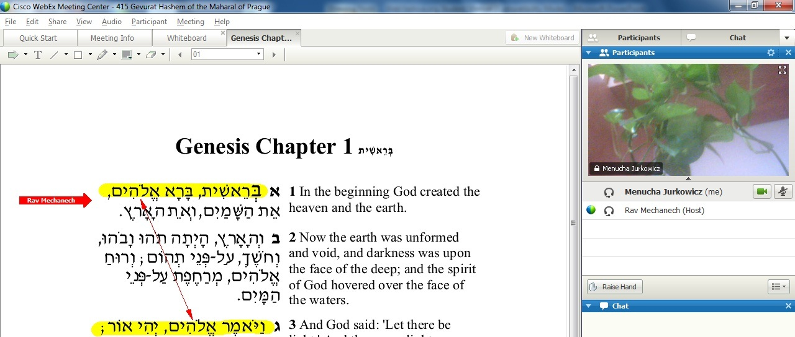
Audio and webcam setup
To mute or unmute yourself, click the icon of the mic.
To turn your webcam on or off, click the icon for the webcam.
If your mic doesn’t work, then you may have a setting issue with your mic and please see the previous slides to fix this.
If it still doesn’t work, contact our support

Slide 21
VoIP Tech Issues & Support
Technical support answers all received emails and calls as quickly as possible. During certain times, such as the start of a new zman, there is a high volume of requests and it may take a bit longer to get back to you. Feel free to send us a reminder email in case your first message has gone astray, and have patience that we will address your request as soon as we can! Contact information for technical support is on the last slide.
Here are some of the most common issues regarding VoIP:
Difficulty Hearing Teacher's Sound:
If you cannot hear him at all, please check the VoIP settings. It seems like an issue with your Audio settings.
  If you can hear the teacher , but the quality is bad, the best way to tell if the problem is with him/her or with you is to try communicate with others in your shiur via the chat box. If they can hear the teacher without a problem, then the issue is most likely with your connection. Do the following:
  Wait a little to see if the issue passes. If it doesn’t
  try to turn off all video. If it still is bad, then
  exit VoIP & re-enter (Audio>Integrated VoIP> Leave Conference and then repeat to re-enter) if it still is bad then…
  exit session and re-enter
  else contact support.
  If the issue is by everyone, then chat to the teacher . The teacher should try to fix it on his end. Write to the WebYeshiva office to notify them of the issue with that teachers VoIP

Slide 22
Web conference setup
You can turn off or on the main picture by clicking on the small arrow.
You can see the participants in picture form instead of a list, by clicking on the list button and choosing thumbnails. On the next page you can see what it would look like

Slide 23
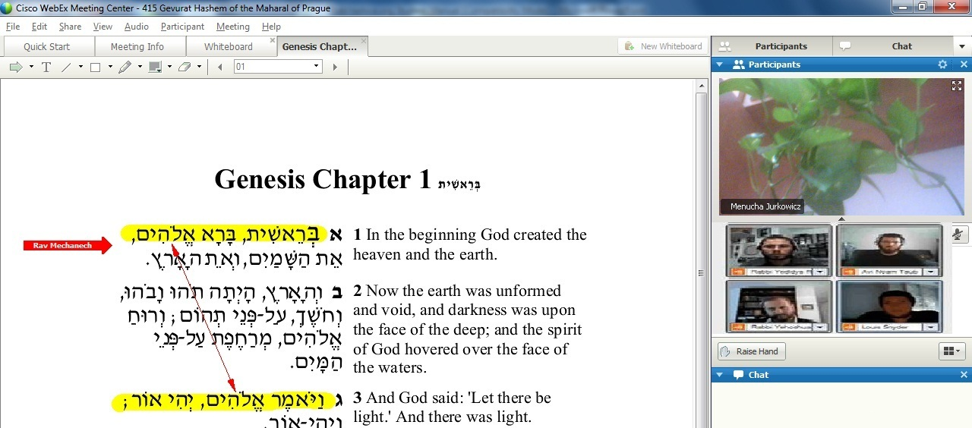
Audio and webcam setup
You can go back to list form by clicking on it again and choosing list.

Slide 24
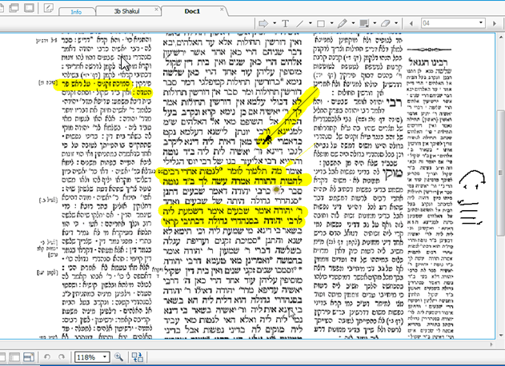

Inside the WebEx Classroom- The Shiur
As the shiur is started, students can follow along thanks to WebEx annotation tools.

Slide 25
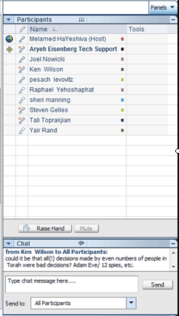
Inside the WebEx Classroom- chat
You can communicate by using the text chat feature. Enter your chat message here and click on “send”.
You can send the chat to the entire class by choosing send to “everyone”
You can also choose to send a private chat to any participant or the teacher by choosing their name from the drip down menu (beware, if you send a private chat, do not send it to everyone, as it may cause discomfort.
everyone

Slide 26
Inside the WebEx Classroom- The Shiur
Students can raise their hands at any time in order to ask a question or to make a comment.
To talk, either unmute or have the teacher do so for you as in the above slides
Student Raise Hand

Slide 27
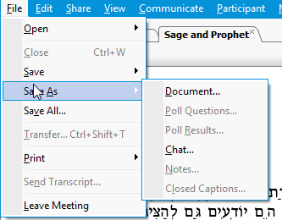
Inside the WebEx Classroom- The Shiur
All source material is clearly displayed and is available for students to download for later use.
All shiurim are recorded and are available as archives.

Slide 28
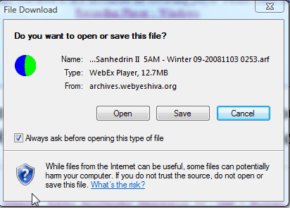
Accessing Archives
Archives are usually available within 24 hours of the shiur
To view the archives you must first download the WebEx player (This needs to be done only once)
Download the archive
Many shiurim have the option of downloading the shiur in WebEx format or in mp4 format

Slide 29
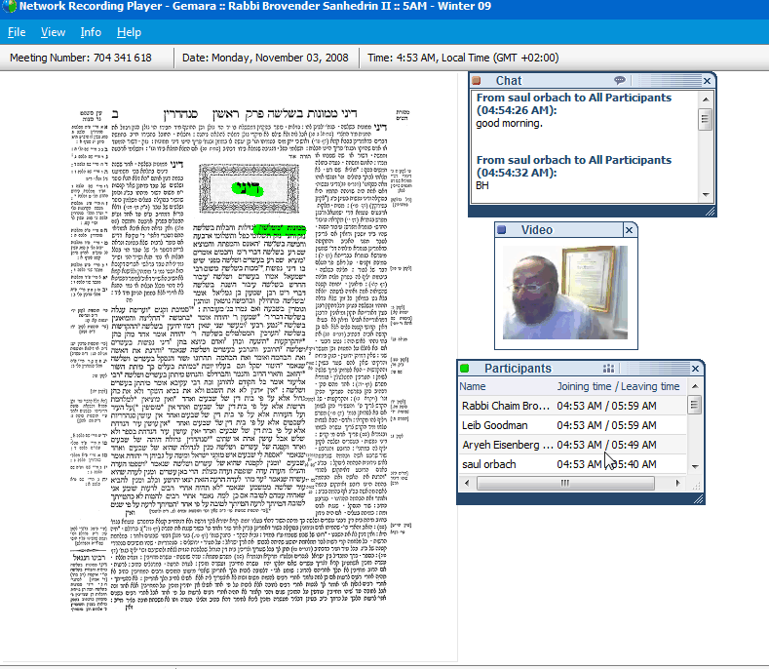
Accessing WebYeshiva Archives
The archive file opens easily with the WebEx Recording Player.
View all of the sources, communications, and videos that took place during the actual shiur.

Slide 30
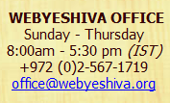
For More Information…
  www.webyeshiva.org

Slide 31
For Technical Support…
  24/6 TECH SUPPORT
  U.S. 1-212-920-8844 · Israel (0)3-900-3015 support@webyeshiva.org

